Slide 1


19EC786
Analog VLSI design

Slide 2
19EC786 – Analog VLSI design
Syllabus
UNIT I BASIC MOS DEVICES 9
Depletion region of PN junction - Band diagram of MOS capacitor – Accumulation, Depletion, inversion region- Large and small signal behavior of MOSFET- short channel effects in MOS transistors – weak inversion in MOS transistors- substrate current flow in MOS transistor.
UNIT II HIGH FREQUENCY CMOS AMPLIFIERS AND CURRENT MIRROR CIRCUITS 9
Common source, common drain, common gate. Differential amplifiers-Cascode amplifiers-Current amplifiers–power amplifiers- Current sources and sinks ,MOS Current Mirrors – Simple, Cascode, Wilson and Widlar current source.
UNIT III CMOS OPERATIONAL AMPLIFIER 9
Design of CMOS Op amps - Compensation of Op amps- Low voltage Op amps - Low noise Op amps Two stage MOS Operational Amplifiers with Cascode, MOS Telescopic - Cascode Operational Amplifier, MOS Folded Cascode and MOS Active Cascode Operational Amplifiers.
UNIT IV COMPARATORS AND SWITCHED CAPACITOR CIRCUITS 9
Characterization of a Comparator -two-Stage Open-Loop Comparators - Improving the Performance of Open-Loop Comparators-Discrete-Time Comparators - High-Speed Comparators- Switched Capacitor Circuits – Switched Capacitor Amplifiers - Switched Capacitor Integrators
UNIT V A/D AND D/A CONVERTERS 9
Characterization of D/A converters- Parallel D/A converters-extending the resolution of parallel D/A converters- Serial D/A converters- Characterization of A/D converters-Serial A/D converters- Medium and high speed A/D converters.

Slide 3
UNIT IV COMPARATORS AND SWITCHED CAPACITOR CIRCUITS
UNIT IV COMPARATORS AND SWITCHED CAPACITOR CIRCUITS
Characterization of a Comparator
Two-Stage Open-Loop Comparators
Improving the Performance of Open-Loop Comparators
Discrete-Time Comparators
High-Speed Comparators
Switched Capacitor Circuits
Switched Capacitor Amplifiers
Switched Capacitor Integrators

Slide 4

UNIT IV COMPARATORS AND SWITCHED CAPACITOR CIRCUITS
Characterization of a Comparator
A positive voltage applied at the V_{P} input will cause the comparator output to go positive.
A positive voltage applied at the V_{N} input will cause the comparator output to go negative.
The upper and lower voltage limits of the comparator output are defined as V_{oH} and V_{oL} respectively.
Circuit symbol for a comparator.
Static Characteristics:
Gain
Input Resolution
Input Offset Voltage (V_{OS})
Noise
Dynamic Characteristics:
Propagation delay time
Slew Rate

Slide 5
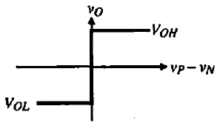


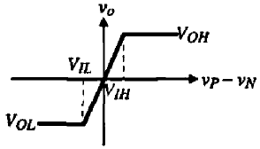
UNIT IV COMPARATORS AND SWITCHED CAPACITOR CIRCUITS
Characterization of a Comparator
Static Characteristics
As shown in the figure the output of the comparator is high (V_{OH}) when the difference between the non-inverting and inverting inputs is positive, and low (V_{OL}) when this difference is negative.
Ideal transfer curve of a comparator.
Gain
The output changes states for an input change of ΔV.
When ΔV approaches zero, this implies a gain of infinity,
where V_{IH} and V_{IL} represent the input-voltage difference V_{P} – V_{N} needed to just saturate the output at its upper and lower limit,
Transfer curve of a comparator with finite gain.

Slide 6
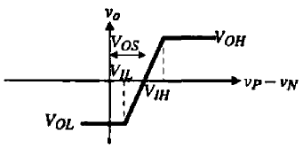
UNIT IV COMPARATORS AND SWITCHED CAPACITOR CIRCUITS
Characterization of a Comparator
Static Characteristics
Input Resolution
The change in input is called the resolution of the comparator.
The minimum amount of input change (resolution) necessary to make the output swing between the two binary states.
These two output states are usually defined by the input requirements of the digital circuitry driven by the comparator output.
Input Offset Voltage (V_{OS})
Ideally, the output changes as the input difference crosses zero.
If the output did not change until the input difference reached a value +V_{OS,} then this difference would be defined as the offset voltage.
The ± sign of the offset voltage accounts for the fact that V_{OS} is unknown in polarity.
Transfer curve of a comparator including input-offset voltage.

Slide 7
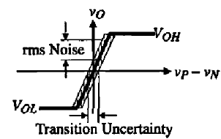
UNIT IV COMPARATORS AND SWITCHED CAPACITOR CIRCUITS
Characterization of a Comparator
Static Characteristics
Noise
The comparator can have a differential input resistance, input capacitance, an output resistance and an input common-mode resistance, R_{icm}.
The ICMR (Input Common-Mode Range) for a comparator would be that range of input common-mode voltage over which the comparator functions normally.
This input common-mode range is generally the range where all transistors of the comparator remain in saturation.
Even though the comparator is not designed to operate in the transition region between the two binary output states, noise is still important to the comparator.
The noise will lead to an uncertainty in the transition region as shown in Fig.
The uncertainty in the transition region will lead to jitter or phase noise in the circuits.
Influence of noise on a comparator.

Slide 8
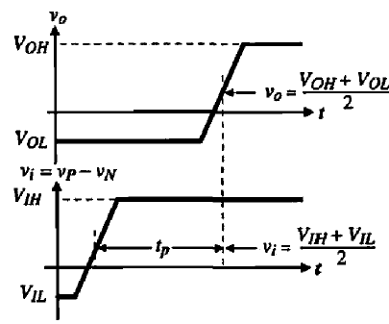

UNIT IV COMPARATORS AND SWITCHED CAPACITOR CIRCUITS
Characterization of a Comparator
Dynamic Characteristics
Propagation delay time
The characteristic delay between input excitation and output transition is the time response of the comparator.
There is a delay between the input excitation and the output response. This time difference is called the propagation delay time of the comparator.
It is a very important parameter since it is often the speed limitation in the conversion rate of an A/D converter.
The propagation delay time in comparators generally varies as a function of the amplitude of the input.
A larger input will result in a smaller delay time. There is an upper limit at which a further increase in the input voltage will no longer affect the delay.
Propagation delay time of a non-inverting comparator.
The minimum change of voltage at the input of the comparator is equal to the resolution of the comparator. This minimum input voltage to the comparator as

Slide 9

UNIT IV COMPARATORS AND SWITCHED CAPACITOR CIRCUITS
Characterization of a Comparator
Dynamic Characteristics
Slew Rate
As the overdrive increases to the comparator eventually the comparator enters a large signal mode of operation.
Under large-signal operation, a slew-rate limit will occur due to limited current to charge or discharge capacitors.
If the propagation delay time is determined by the slew-rate of the comparator, then this time can be written as
In the case where the propagation time is determined by the slew rate, the most important factor to decrease the propagation time is increasing the sinking or sourcing capability of the comparator.

Slide 10
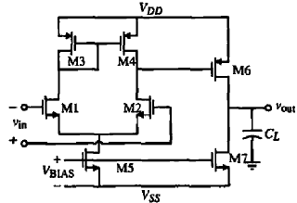
UNIT IV COMPARATORS AND SWITCHED CAPACITOR CIRCUITS
TWO-STAGE OPEN-LOOP COMPARATORS
A close examination of the previous requirements for a comparator reveal that it requires a differential input and sufficient gain to be able to achieve the desired resolution.
A simplification occurs because the comparator will generally be used in an open-loop mode and therefore it is not necessary to compensate the comparator.
In fact it is preferred not to compensate the comparator so that it has the largest bandwidth possible, which will give a faster response.
Two-stage comparator
The first item of interest is the values of V_{OH} and V_{OL} for the two-stage comparator.
The maximum output voltage, a.;suming that the gate of M₆ bas a minimum voltage given as V_{G6}(lnin), can be expressed as

Slide 11





UNIT IV COMPARATORS AND SWITCHED CAPACITOR CIRCUITS
TWO-STAGE OPEN-LOOP COMPARATORS
The minimum output voltage is,
The small-signal gain of the comparator is given as,
The comparator has two poles of interest. One is the output pole of the first stage, p1, and the second is the output pole of the second stage, p2.
These poles are expressed as,
C_{I} is the sum of the capacitances connected to the output of the first stage and C_{II} is the sum of the capacitances connected to the output of the second stage. C_{II} will generally be dominated by C_{L}.
The frequency response of the two-stage comparator can be expressed using the above results as,

Slide 12
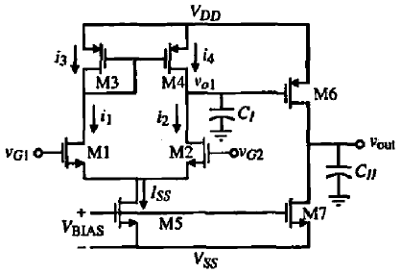
UNIT IV COMPARATORS AND SWITCHED CAPACITOR CIRCUITS
Initial Operating States for the Two-stage Open-loop Comparators
Approach:
Our approach will be to choose one of the input gates equal to a DC voltage and find the output voltage of the first and second stages when the other input gate is above and below the de voltage on the first gate.
Actually, we need to consider two cases for each of the previous possibilities.
These cases are when the currents in M1 and M2 are different but neither is zero and when one of the input transistors has a current of I_{ss} and the other current is zero.
Two-stage, open-loop comparator used to find initial states
The capacitances at the outputs of the first and second stages are C_{I} and C_{II} respectively.

Slide 13
UNIT IV COMPARATORS AND SWITCHED CAPACITOR CIRCUITS
Initial Operating States for the Two-stage Open-loop Comparators
Condition: i
We begin by first assuming that M2 of v_{G2} is equal to a DC voltage, V_{G2.}
M2 is applied with constant DC voltage and M1 is having variable input voltage.
Initially, V_{G1} > V_{G2} with i₁ < I_{ss} & i₂ > 0.
In this case, as long as M4 remains in saturation, i₄ = i₃ = i₁, which is greater than i₂ (Simple Current Mirror). ((i₄ = i₃ = i₁) > i₂)
Capacitor C_{I} receives difference of current (i₄ - i₂) for the charging, whose potential is V_{O1}.
When the capacitor C_{I} continuously charging V_{O1} increasing, and when V_{ds4} <V_{gs4} – V_{tp}, then M4 enters into the triode region, which causes i₄ <i₃.
If V_{ds4} continuously decreasing, and when i₄ = i₂, then the V_{O1} stabilizes.
The value of voltage of the first stage is,
V_{DD} - V_{SD4}(sat) < V_{O1} < V_{DD} (V_{SD4} is equal to Zero)
V_{G1} > V_{G2}
i₁ < I_{ss} and i₂ > 0
Under the conditions V_{SG6} < V_{tp} and M6 will be off and the output voltage will be,
V_{OUT} = V_{SS}; V_{G1} > V_{G2}; i₁ < I_{SS} and i₂ > 0

Slide 14
UNIT IV COMPARATORS AND SWITCHED CAPACITOR CIRCUITS
Initial Operating States for the Two-stage Open-loop Comparators
Condition: ii
if V_{G1} >> V_{G2} , then
i₁ = I_{SS} & i₂ = 0.
V_{O1} < V_{DD} ; V_{OUT} = V_{SS}
Condition: iii
We begin by first assuming that v_{G2} is equal to a DC voltage, V_{G2.}
Initially, V_{G1} < V_{G2} with i₁ > 0 & i₂ < I_{ss}.
In this case, i₄ = i₃ = i₁, which is less than i₂ (Simple Current Mirror). ((i₄ = i₃ = i₁) < i₂)
V_{O1} is started decreasing and current i₂ is also decreasing.
When V_{ds2} < V_{gs2} – V_{tn}, (or) V_{O1} < V_{G2} – V_{tn} then M2 becomes active.
As V_{O1} continuously decreasing then v_{DS2} < V_{DS2}(Sat), and the current through the M2 is decreases until, i₁ = i₂ = I_{SS}/2 at which the V_{O1} stabilizes.
At this point, the value of voltage of the first stage is,
V_{S2} < V_{O1} < V_{S2} + V_{DS2}(Sat)
V_{G1} < V_{G2}
i₁ > 0 and i₂ < I_{ss}
Then, the output voltage of the 2nd stage is V_{DD},
V_{O1}< V_{SS} ; V_{OUT} = V_{DD}.

Slide 15
UNIT IV COMPARATORS AND SWITCHED CAPACITOR CIRCUITS
Initial Operating States for the Two-stage Open-loop Comparators
Condition: iv
if V_{G1} << V_{G2} , then
i₁ = 0 & i₂ = I_{SS}.
V_{O1} = V_{SS} ; V_{OUT} = V_{DD}
Condition: v
M1is applied with constant DC voltage and M2 is having variable input voltage.
Now, input at M1 is V_{G1}, and V_{G1} > V_{G2} with i₁ > 0 & i₂ < I_{ss}.
As a result of i₁ < i₂ gives i₄ < i₂ (i₄ = i₃ = i₁), which is less than i₂ (Simple Current Mirror). ((i₄ = i₃ = i₁) < i₂). M4 is in saturation region.
Capacitor C_{I} receives difference of current (i₄ - i₂) for the discharging, whose potential is V_{O1} started decreasing, which causes M2 is in Triode region.
i₂ will ceases to decrease when i₁ = i₂ = I_{SS}/2, then V_{O1} stabilizes, which has a value for the voltage of the first stage is,
V_{S2} < V_{O1} < V_{S2} + V_{DS2}(sat);
i₁ > 0 & i₂ < I_{ss}
The output voltage will be (V_{DS6} > V_{GS6} - V_{tp}),
V_{OUT} = V_{DD};

Slide 16
UNIT IV COMPARATORS AND SWITCHED CAPACITOR CIRCUITS
Initial Operating States for the Two-stage Open-loop Comparators
Condition: vi
if V_{G1} >> V_{G2} , i₂ is decreasing towards I_{SS} and V_{O1} decreases towards V_{SS}.
i₂ = I_{SS} .
V_{O1} = V_{SS} ; V_{OUT} = V_{DD}
Condition: vii
We are assuming that v_{G1} is equal to a DC voltage, V_{G1.}
Initially, V_{G2} < V_{G1} with i₁ < I_{ss} & i₂ > 0.
As a result of i₁ > i₂ => i₄ > i₂ [(i₄ = i₃ = i₁)].
Now, V_{O1} is started increasing by a current (i₄ - i₂ ) and current i₂ is also increasing.
As long as M2 is saturated, i₄ > i_{2.}
When V_{ds4} < V_{gs4} – V_{tp}, then M2 becomes triode condition.
Now, i₄ = i₂ at which the V_{O1} stabilizes.
At this point, the output voltage of the first stage is,
V_{DD} - V_{SD4}(sat) < V_{O1} < V_{DD}
V_{G1} < V_{G2}
i₂ > 0 and i₁ < I_{ss}
Then, the output voltage of the 2nd stage is V_{DD},
V_{O1}< V_{DD} ; V_{OUT} = V_{SS} ; i₁ = I_{ss} and i₂ = 0

Slide 17
UNIT IV COMPARATORS AND SWITCHED CAPACITOR CIRCUITS
Initial Operating States for the Two-stage Open-loop Comparators
Condition: viii
if V_{G2} << V_{G1} ,
i₁ = I_{SS} and i₂ = 0
V_{O1} = V_{DD} ; V_{OUT} = V_{SS}

Slide 18
UNIT IV COMPARATORS AND SWITCHED CAPACITOR CIRCUITS
Initial Operating States for the Two-stage Open-loop Comparators
S. No. | M1 | M2 | Condition | Currents (i₁, i₂ , i₃, i₄) | Capacitor (C_{I}) | V_{O1} | V_{OUT}
1. | Variable DC | Fixed DC | V_{G1}>V_{G2} | i₁<I_{SS}; i₂>0; (i₄=i₃=i₁)>i₂ | Charging for (i₄-i₂) | <V_{DD} | =V_{SS}
2. | Variable DC | Fixed DC | V_{G1}>>V_{G2} | i₁=I_{SS}; i₂=0; (i₄=i₃=i₁)=i₂ | No action | =V_{DD} | =V_{SS}
3. | Variable DC | Fixed DC | V_{G1}<V_{G2} | i₁>0; i₂<I_{SS}; (i₄ = i₃ = i₁) < i₂ | Discharging for (i₄-i₂) | =V_{SS} | = ~V_{DD}
4. | Variable DC | Fixed DC | V_{G1}<<V_{G2} | i₁=0; i₂=I_{SS}; (i₄=i₃=i₁)=i₂ | No action | =V_{SS} | = V_{DD}
5. | Fixed DC | Variable DC | V_{G1}<V_{G2} | i₁>0; i₂<I_{SS}; (i₄ = i₃ = i₁) < i₂ | Discharging for (i₄-i₂) | =V_{SS} | = ~V_{DD}
6. | Fixed DC | Variable DC | V_{G1}<<V_{G2} | i₁=0; i₂=I_{SS}; (i₄=i₃=i₁)=i₂ | No action | =V_{SS} | = V_{DD}
. | Fixed DC | Variable DC | V_{G1}>V_{G2} | i₁<I_{SS}; i₂>0; (i₄=i₃=i₁)>i₂ | Charging for (i₄-i₂) | <V_{DD} | =V_{SS}
8. | Fixed DC | Variable DC | V_{G1}>>V_{G2} | i₁=I_{SS}; i₂=0; (i₄=i₃=i₁)=i₂ | No action | =V_{DD} | =V_{SS}

Slide 19
UNIT IV COMPARATORS AND SWITCHED CAPACITOR CIRCUITS
Design of Two-stage Open-loop Comparators
Assume the specifications of two stage comparator are given as below:
t_{p}=50ns, V_{DD}= 2.5V, V_{in}(min) = 1 mV, V_{OH}=2V, V_{SS} = -2.5V, V⁺_{icm} = 2V, V_{OL}.= -2V, C_{II} = 5pF, V⁻_{icm} = -1.25V.
Also assume that the overdrive will be a factor of 10. Design a two-stage, open-loop comparator to achieve the above specifications and assume that all channel lengths are to be 1 μm.

Slide 20
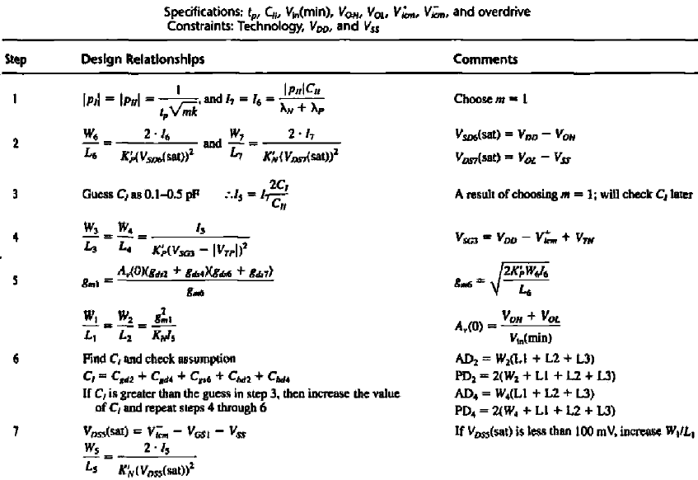

Slide 21
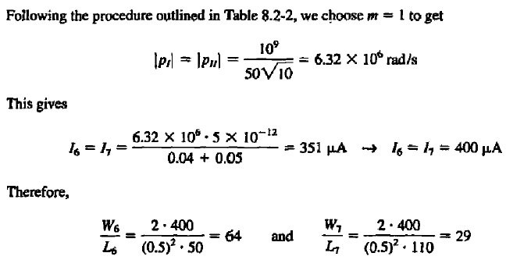
UNIT IV COMPARATORS AND SWITCHED CAPACITOR CIRCUITS
Design of Two-stage Open-loop Comparators

Slide 22
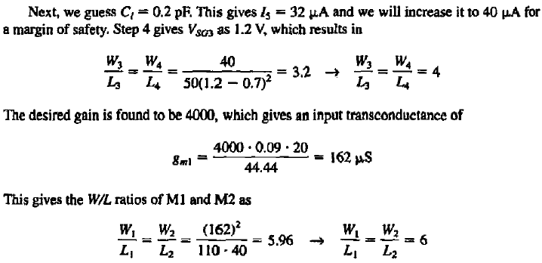
UNIT IV COMPARATORS AND SWITCHED CAPACITOR CIRCUITS
Design of Two-stage Open-loop Comparators

Slide 23
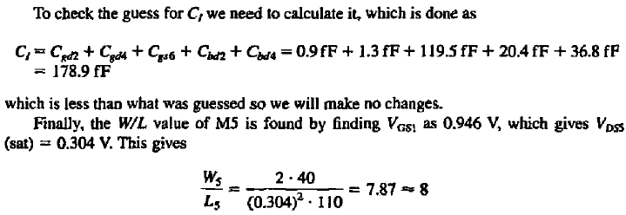
UNIT IV COMPARATORS AND SWITCHED CAPACITOR CIRCUITS
Design of Two-stage Open-loop Comparators

Slide 24
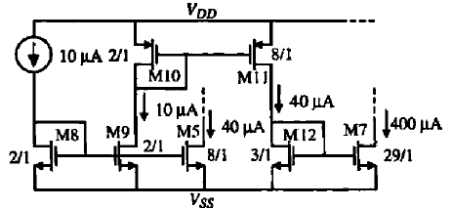

UNIT IV COMPARATORS AND SWITCHED CAPACITOR CIRCUITS
Design of Two-stage Open-loop Comparators

Slide 25
UNIT IV COMPARATORS AND SWITCHED CAPACITOR CIRCUITS
Improving the Performance of Two-stage Open-loop Comparators
There are two areas in which the performance of an open-loop,
Input-offset voltage - Solution: Auto-zeroing
A single transition of the comparator in a noisy environment - Solution: hysteresis using a bistable circuit.
Autozerolng Techniques
Input-offset voltage can be a particularly difficult problem in comparator design.
In precision applications, such as high-resolution AID converters, large input-offset voltages cannot be tolerated.
While systematic offset can nearly be eliminated with proper design (though still affected by process variations), random offsets still remain and are unpredictable.
Method:
These techniques are available in MOS because of the nearly infinite input resistance of MOS transistors.
This characteristic allows long-term storage of voltages on the transistor's gate.
As a result, offset voltages can be measured, stored on capacitors, and summed with the input so as to cancel the offset.

Slide 26
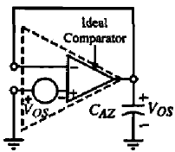
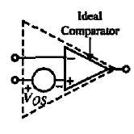
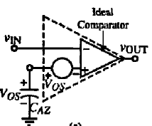
UNIT IV COMPARATORS AND SWITCHED CAPACITOR CIRCUITS
Improving the Performance of Two-stage Open-loop Comparators
Autozerolng Techniques
Simple model of a comparator including offset
C
Comparator in open-loop configuration with offset cancellation achieved at the noninverting input during the second half of the autozero cycle.
Comparator in unity-gain configuration storing the offset on autozero capacitor C_{AZ} during the first half of the autozero cycle.
B
A

Slide 27
UNIT IV COMPARATORS AND SWITCHED CAPACITOR CIRCUITS
Improving the Performance of Two-stage Open-loop Comparators
Autozerolng Techniques
A
A model of a comparator with an input-offset voltage.
A known polarity is given to the offset voltage for convenience.
Neither the value nor the polarity can be predicted in reality.
B
The comparator connected in the unity-gain configuration so that the input offset is available at the output.
In order for this circuit to work properly, it is necessary that the comparator be stable in the unity-gain configuration.
C
The autozero algorithm C_{AZ} is placed at the input of the comparator in series with V_{OS}.
The voltage across C_{AZ} adds to V_{OS}, resulting in zero volts at the noninverting input of the comparator.

Slide 28
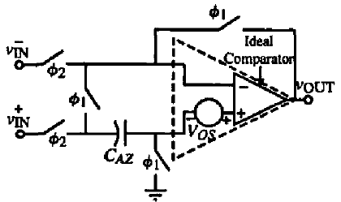
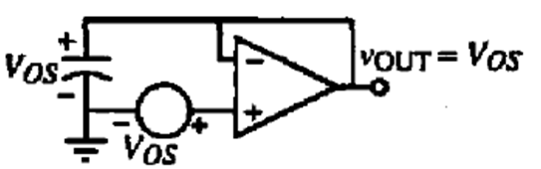
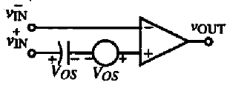
UNIT IV COMPARATORS AND SWITCHED CAPACITOR CIRCUITS
Improving the Performance of Two-stage Open-loop Comparators
Autozerolng Techniques – Practical Implementation
Comparator during φ₁ phase.
The state of the circuit during the first phase of the cycle when φ₁ is high.
The offset is stored across C_{AZ}.
Comparator during φ₂ phase.
1. Differential circuit implementation of an autozeroed comparator.
In the second phase of the autozero cycle when φ₂ is high.
The offset is canceled by the addition of V_{OS} on C_{AZ}.
It is during this portion of the cycle that the circuit functions as a comparator.

Slide 29
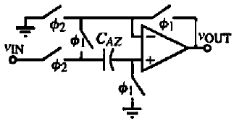
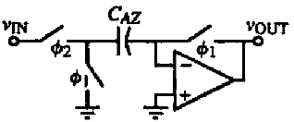
UNIT IV COMPARATORS AND SWITCHED CAPACITOR CIRCUITS
Improving the Performance of Two-stage Open-loop Comparators
Autozerolng Techniques – Practical Implementation
3. Inverting autozeroed comparator.
2. Non-Inverting autozeroed comparator.
The switch implementations of the autozeroed comparator can be single-channel MOSFETs or complementary MOSFETs.
It is important to use nonoverlapping clocks to drive the switches so that any given switch turns off before another turns on.

Slide 30
UNIT IV COMPARATORS AND SWITCHED CAPACITOR CIRCUITS
Improving the Performance of Two-stage Open-loop Comparators
Comparator Using Hysteresis
Often a comparator is placed in a very noisy environment in which it must detect signal transitions at the threshold point.
If the comparator is fast enough and the amplitude of the noise is great enough, the output will also be noisy.
In this situation, a modification on the transfer characteristic of the comparator is desired. Specifically, hysteresis is needed in the comparator.
Hysteresis is the quality of the comparator in which the input threshold changes as a function of the input (or output) level.
In particular, when the input passes the threshold, the output changes and the input threshold is subsequently reduced so that the input must return beyond the previous threshold before the comparator's output changes state again.
The input starts negative and goes positive, the output does not change until it reaches the positive trip point, V⁺_{TRP}.
Once the output goes high, the effective trip point is changed.
When the input returns in the negative direction. the output does not switch until it reaches the negative trip point, V⁻_{TRP}.

Slide 31
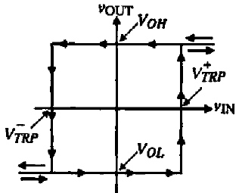
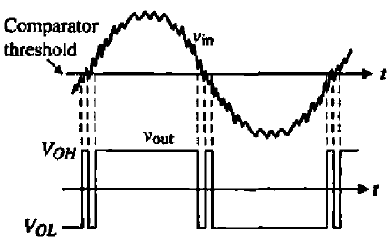
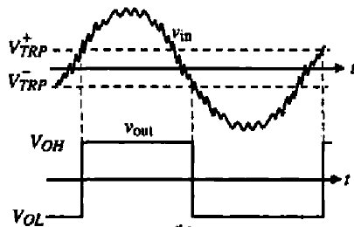
UNIT IV COMPARATORS AND SWITCHED CAPACITOR CIRCUITS
Improving the Performance of Two-stage Open-loop Comparators
Comparator Using Hysteresis
The voltage-transfer function is called a bistable characteristic.
A bistable circuit can be clockwise or counter clockwise.
Sometimes, the counterclockwise bistable circuit is called non-inverting and the clockwise bistable is called inverting.
The bistable characteristic is defined by its width and height and whether it is clockwise or counterclockwise.
The width is given by the difference between V⁺_{TRP} and V⁻_{TRP}.
The height is generally the difference between V_{OH} and VOL.
Comparator transfer curve with hysteresis. (Clockwise)
The response of the comparator can be improved by adding hysteresis equal to or greater than the amount of the largest expected noise amplitude.
Comparator response to a noisy input.
Complll'lltor response to a noisy input when hysteresis is added.

Slide 32
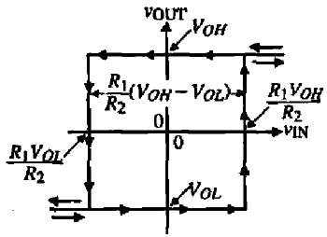
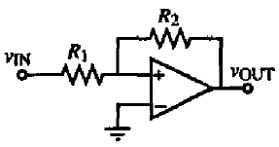


UNIT IV COMPARATORS AND SWITCHED CAPACITOR CIRCUITS
Improving the Performance of Two-stage Open-loop Comparators
Comparator Using Hysteresis
The methods are,
External methods (External Positive Feedback required)
Internal methods (No External Positive Feedback required)
External methods – Non-Inverting
Non-inverting bistable circui1 using external positive feedback.
Assume that V_{IN} is much less than the voltage at the positive input to the comparator.
In this case, the output voltage will be at V_{OL}·
As V_{IN} is increased. the upper trip point, V⁺_{TRP} is found by setting the voltage due to V_{IN} and VoL at the positive input to the comparator equal to zero.

Slide 33



UNIT IV COMPARATORS AND SWITCHED CAPACITOR CIRCUITS
Improving the Performance of Two-stage Open-loop Comparators
Comparator Using Hysteresis
The lower trip point, V⁻_{TRP} can be found by assuming that V_{IN} is much greater than the voltage at the positive input to the comparator so that the output state, which is V_{OH} is known.
As V_{IN} is decreased, V⁻_{TRP} occurs when the voltage at the positive input to the comparator is equal to zero.
The width of the bistable characteristic is given as

Slide 34
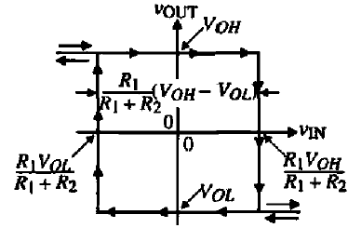
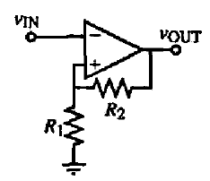



UNIT IV COMPARATORS AND SWITCHED CAPACITOR CIRCUITS
Improving the Performance of Two-stage Open-loop Comparators
Comparator Using Hysteresis
External methods - Inverting
Inverting bistable circui1 using external positive feedback.
The width of the bistable characteristic is given as

Slide 35
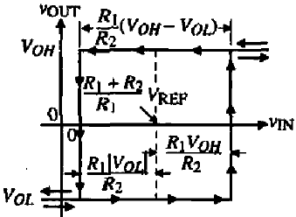
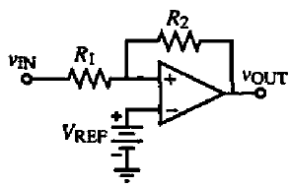

UNIT IV COMPARATORS AND SWITCHED CAPACITOR CIRCUITS
Improving the Performance of Two-stage Open-loop Comparators
Comparator Using Hysteresis
Horizontally shifted noninvcrting bistable circuit
The center point of the bistable characteristics can be shifted horizontally by inserting a battery, V_{R£F}.

Slide 36
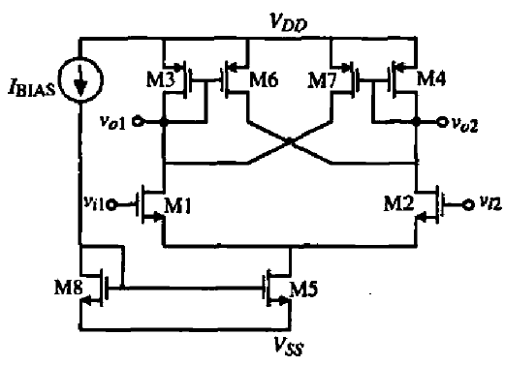
UNIT IV COMPARATORS AND SWITCHED CAPACITOR CIRCUITS
Improving the Performance of Two-stage Open-loop Comparators
Comparator Using Hysteresis
Internal Positive Feedback
In this circuit there are two paths of feedback.
The first is current-series feedback through the common-source node of transistors Ml and M2. This feedback path is negative.
The second path is the voltage-shunt feedback through the gate-drain connections of transistors M6 and M7. This path of feedback is positive.
If the positive-feedback factor is less than the negative-feedback factor, then the overall feedback will be negative and no hysteresis will result.
If the positive-feedback factor becomes greater, the overall feedback will he positive, which will give rise to hysteresis

Slide 37
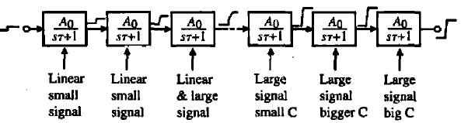
UNIT IV COMPARATORS AND SWITCHED CAPACITOR CIRCUITS
HIGH-SPEED COMPARATORS
A high-speed comparator should have a propagation delay time as small as possible.
In order to achieve this goal, one must understand the requirements for a fast comparator.
This is best understood by separating the comparator into a number of cascaded stages.
Conceptual illustration of a cascaded comparator.
A number of stages with a gain of A₀ and a single pole at 1/T are shown. If the input change is slightly larger than Vm(min), then the function of the stages is to amplify the input with as little delay per stage as possible.
As the signal swing begins to approach the desired range, the amplifiers will be limited by their slew rate. Thus, for initial stages, the important parameter is to have a high bandwidth so that there is little delay in amplifying the signal and passing it on to the next stage.
However, at the end of the cascade of amplifiers, it is more important to have a high slew rale capability so that the voltage across the interstage capacitors and the load capacitor rises or falls quick enough.

Slide 38
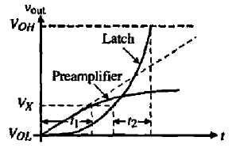
UNIT IV COMPARATORS AND SWITCHED CAPACITOR CIRCUITS
HIGH-SPEED COMPARATORS
The basic principle behind the high-speed comparator is to use a preamplifier to build up the input change to a sufficiently large value and then apply it to the latch.
This combines the best aspects of circuits with a negative exponential response (the preamplifier) with circuits with a positive exponential response (the latch).
The gain of the preamplifier times the input voltage is not sufficient to reach the desired output level.
Rather, during time t₁ the preamplifier amplifies the input voltage to a value of Vx·
The voltage Vx is applied to the latch input, which then goes to the desired output voltage in time t_{2 .}
Thus, the total response time is t₁ + t_{2 .}
Since the preamplifier is working in the linear region, this means that the bandwidth must be as large as possible.
We know that the gain bandwidth of an amplifier is normally constant. If a number of low-gain, wide-bandwidth amplifiers are cascaded, the delay time, t₁, can be minimized.
Preamplifier and latch step response
In fact, it has been shown that the optimum number of identical low gain amplifiers is six each with a gain of 2.72.

Slide 39
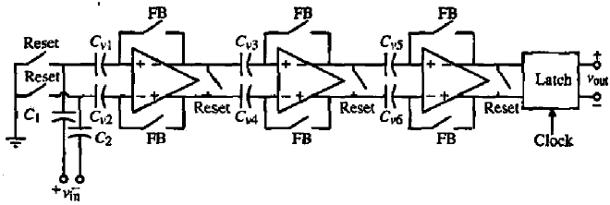

UNIT IV COMPARATORS AND SWITCHED CAPACITOR CIRCUITS
HIGH-SPEED COMPARATORS
Fully differential, three-stage comparator and latch
A high-speed comparator using three cascaded low-gain amplifier; as the preamplifier and a latch at the output is shown in Fig.
When the FB and Reset switches are closed, the capacitors designated as C_{V} are autozeroed for each amplifier.
Unfortunately, each amplifier must be autozeroed by itself. More switches would be required to autozero all three amplifiers at the same time.
The input is applied through the capacitors C₁ and C₂.
The low-gain preamplifiers must compromise between a high bandwidth and sufficient gain.
The gain of this preamplifier is,

Slide 40
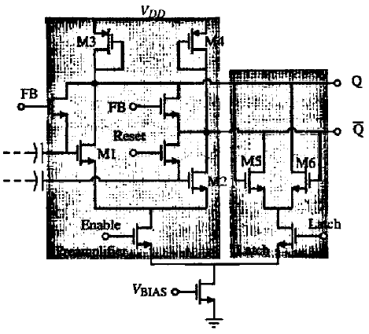
UNIT IV COMPARATORS AND SWITCHED CAPACITOR CIRCUITS
HIGH-SPEED COMPARATORS
There are several problems with the preamplifier.
One is that the gain is very small even for large differences of W/L values.
Another is that there is no isolation between the latch outputs and the inputs to the preamplifier.
Rapid changes in the output of the latch can propagate through the drain-gate capacitances of Ml and M2 and appear at the input of the latch.
Example of a Preamplifier and Latch

Slide 41
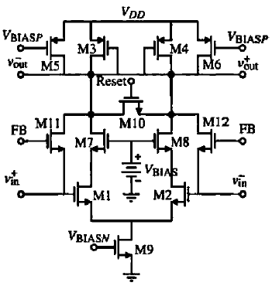
UNIT IV COMPARATORS AND SWITCHED CAPACITOR CIRCUITS
HIGH-SPEED COMPARATORS
Figure shows a preamplifier that solves the previous two problems.
Transistors M5 and M6 are used to increase the current in M1 and M2 so that the gain is enhanced by the square root of the difference of currents in Ml and M2 to the currents in M3 and M4.
The use of a preamplifier before the latch also bas the advantage of
Reducing the input offset voltage of the latch by the gain of the preamplifier.
The input-offset voltage of the comparator will now become that of the preamplifier, which can be autozeroed, resulting in small values of input-offset voltage.
An improved preamplifier

Slide 42
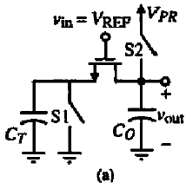
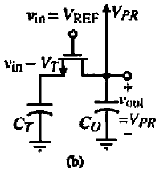
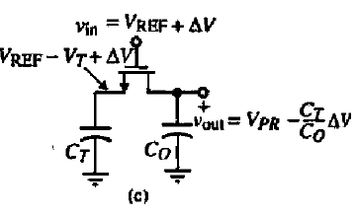
UNIT IV COMPARATORS AND SWITCHED CAPACITOR CIRCUITS
HIGH-SPEED COMPARATORS
Charge Transfer amplifier
Precharge Phase
Amplification Phase
The preamplifier can be replaced by a charge-transfer circuit resulting in simplification of the preamplifier.
A simple charge-transfer circuit has the capacitor C_{T} is larger than C₀.

Slide 43
UNIT IV COMPARATORS AND SWITCHED CAPACITOR CIRCUITS
HIGH-SPEED COMPARATORS
This charge-transfer amplifier has three phases of operation.
The first phase of operation is a reset phase, where switch S_{l} is closed discharging C_{T}.
The second phase is the precharge phase, where switch S₂ is closed. In this phase, the capacitor C_{T} is charged to V_{in} – V_{T} and the output capacitor, C₀. is charged to the preset voltage, V_{PR}·
The third phase is the amplification phase, where both switches are open. In this phase, the input has been assumed to change by an amount ΔV. This causes a current to flow in C_{T} , which also flows in C₀. Since the charge change must be equal for both C_{T} and C_{0,} the change across C₀ is (C_{T} / C₀) ΔV.
The charge-transfer amplifier bas several problems
The first is that only positive values of voltage will be amplified
The second is that large offset voltages result as a function of the sub-threshold current

Slide 44
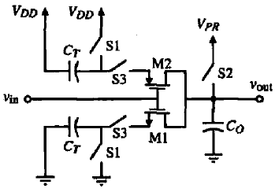
UNIT IV COMPARATORS AND SWITCHED CAPACITOR CIRCUITS
HIGH-SPEED COMPARATORS
A circuit that solves these problems is the use of both NMOS and PMOS transistors. Switches S3 are used to prevent a current path during the reset phase.
CMOS charge-transfer preamplifier

Slide 45
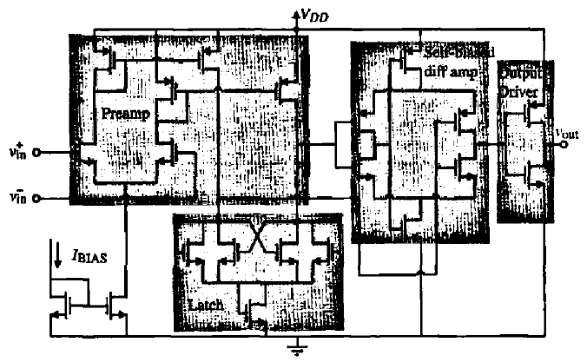
UNIT IV COMPARATORS AND SWITCHED CAPACITOR CIRCUITS
HIGH-SPEED COMPARATORS
A high-speed comparator using a cascade of a preamplifier. latch, self-biased differential amplifier, and output driver.

Slide 46
UNIT IV COMPARATORS AND SWITCHED CAPACITOR CIRCUITS
Discrete-Time Comparators
In many applications the comparator only functions over a portion of a time period.
Such circuits are driven by a clock and will have a portion of time or phase when the comparator is functioning as a comparator and a phase when the comparator is not being used.
In this circumstance, other forms of comparators can be used that are efficient and have a small propagation delay time.
Other Comparator Forms,
Switched Capacitor Comparators
The regenerative comparator

Slide 47
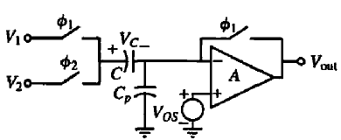
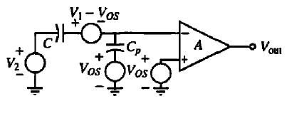
UNIT IV COMPARATORS AND SWITCHED CAPACITOR CIRCUITS
Discrete-Time Comparators
Switched Capacitor Comparators
A switched capacitor comparator
Equivalent circuit when the φ₂ switches are closed.

Slide 48


UNIT IV COMPARATORS AND SWITCHED CAPACITOR CIRCUITS
Discrete-Time Comparators
Switched Capacitor Comparators
The switched capacitor comparator uses a combination of switched capacitors and open-loop comparators.
The advantages of the switched capacitor comparator are that differential signals can be compared using single-ended circuits and the switched capacitor comparator naturally lends itself to autozeroing the de offset voltage of the open-loop comparator.
The voltages applied to the circuit are normally sampled and held so that capital variables are used.
When the φ₁ switches are closed, the capacitor C autozeros the offset voltage of the comparator, V_{OS}·
The capacitor C_{P} represents the parasitic capacitance from the input of the comparator to ground.
The comparator must be stable in unity-gain operation for this circuit to work properly.
It can be shown that the voltage across C and C_{P} at the end of the φ₁ phase period is,

Slide 49



UNIT IV COMPARATORS AND SWITCHED CAPACITOR CIRCUITS
Discrete-Time Comparators
Switched Capacitor Comparators
Now when the φ₂ switch is closed, the equivalent circuit at the beginning of the φ₂ phase period is shown in Fig.
In this circuit, the voltage across each capacitor has been removed and represented by a step voltage source.
If C_{P} is smaller than C. then

Slide 50
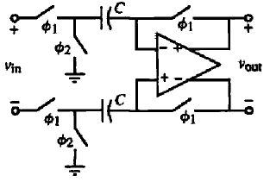
UNIT IV COMPARATORS AND SWITCHED CAPACITOR CIRCUITS
Discrete-Time Comparators
Switched Capacitor Comparators
The gain of the comparator used for the switched capacitor comparator must be large enough to satisfy the resolution requirements.
The speed of the comparator depends on how long it takes the circuit to settle to its steady stage after the switches have been closed for a given period.
During the φ₁ phase, the response of the circuit is very fast. During φ₂, the open loop response of the comparator will determine the speed.
A differential-in, differential-out, switched capacitor comparator.
The input is sampled on the two identical capacitors, C during the φ₁ phase period.
The de offsets of the differential in, differential-out comparator are also autozeroed during this period.
During the φ₂ phase period, the voltages sampled across the capacitors are applied to the comparator input.

Slide 51
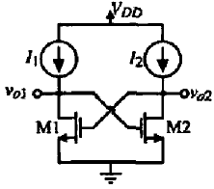
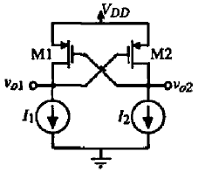
UNIT IV COMPARATORS AND SWITCHED CAPACITOR CIRCUITS
Discrete-Time Comparators
Regenerative Comparators
Regenerative comparators use positive feedback to accomplish the comparison of two signals.
The regenerative comparator is also called a latch or a bistable.
The simplest form of a latch is shown in Fig. consists of two cross-coupled MOSFETs.
The current sources/sinks are used to identify the de currents in the transistors.
NMOS Latch
PMOS Latch

Slide 52
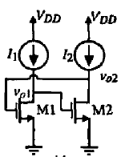
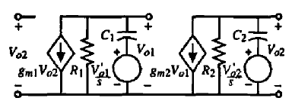
UNIT IV COMPARATORS AND SWITCHED CAPACITOR CIRCUITS
Discrete-Time Comparators
Regenerative Comparators
Normally, the latch has two modes of operation.
The first mode disables the positive feedback and applies the input signal to the terminals designated as V_{O1} and V_{O2}. The initial voltages applied during this mode will be designated as V_{O1}` and V_{O2}`.
The second mode enables the latch and depending on the relative values of V_{O1}` and V_{O2}` one of the outputs will go high and the other will go low. A two-phase clock is used to determine the modes of operation.
Redrawing of NMOS

Slide 53


UNIT IV COMPARATORS AND SWITCHED CAPACITOR CIRCUITS
Discrete-Time Comparators
Regenerative Comparators
The nodal equations
Solving the above,
T_{i} is Time Constant: R_{i}C_{i}.
Assume all transistors are identical: g_{m1} = g_{m2} = g_{m}; R₁=R₂=R; C₁=C₂=C; T₁=T₂= T.

Slide 54


UNIT IV COMPARATORS AND SWITCHED CAPACITOR CIRCUITS
Discrete-Time Comparators
Regenerative Comparators
T_{i} is Time Constant: R_{i}C_{i}.
Assume all transistors are identical: g_{m1} = g_{m2} = g_{m}; R₁=R₂=R; C₁=C₂=C; T₁=T₂= T.
Hence,
The latch time response is,

Slide 55
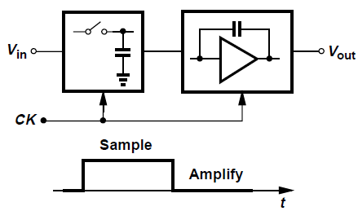
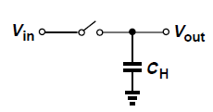
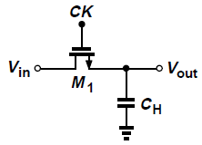
UNIT IV COMPARATORS AND SWITCHED CAPACITOR CIRCUITS
Switched Capacitor Amplifiers
The operation takes place in two phases: sampling and amplification.
In addition to the analog input, Vin, the circuit requires a clock to define each phase.
MOSFETS as Switches
A simple sampling circuit consists of a switch and a capacitor.
A MOS transistor can serve as a switch because,
It can be on while carrying zero current, and
Its source and drain voltages are not “pinned” to the gate voltage,

Slide 56


UNIT IV COMPARATORS AND SWITCHED CAPACITOR CIRCUITS
Switched Capacitor Amplifiers
Case: I
First consider the simple cases depicted in Fig., where the gate command, CK, goes high at t = t₀.
We assume that Vin = 0 for t > t₀ and the capacitor has an initial voltage equal to V_{DD}.
Thus, at t = t₀, M₁ senses a gate-source voltage equal to V_{DD} while its drain voltage is also equal to V_{DD}. The transistor therefore operates in saturation region.
As V_{out} falls, at some point V_{out} = V_{DD} – V_{TH}, driving M₁ into the triode region.
The device nevertheless continues to discharge C_{H} until V_{out} approaches zero.
We note that for V_{out} < 2(V_{DD} - V_{TH}), the transistor can be viewed as a resistor equal to R_{on}.

Slide 57


UNIT IV COMPARATORS AND SWITCHED CAPACITOR CIRCUITS
Switched Capacitor Amplifiers
Case: II
Now consider the case in Fig., where Vin = +1V, V_{out} (t = t0) = 0 V, and V_{DD} = 3 V.
Here, the terminal ofM₁ connected to C_{H} acts as the source, and the transistor turns on with VGS = +3 V, but V_{DS} = +1 V.
Thus, M₁ operates in the triode region, charging C_{H} until V_{out} approaches +1V.
For V_{out} = +1V, the M₁ exhibits an on-resistance of R_{on}.
The above two cases reveals two important points.
First, a MOS switch can conduct current in either direction simply by exchanging the role of its source and drain terminals.
Second, when the switch is on, V_{out} follows V_{in} and when the switch is off, V_{out} remains constant.
Thus, the circuit “tracks” the signal when CK is high and “freezes” the instantaneous value of Vin across C_{H} when CK goes low.

Slide 58

UNIT IV COMPARATORS AND SWITCHED CAPACITOR CIRCUITS
Switched Capacitor Amplifiers - Speed Considerations
What determines the speed of the sampling circuits?
A simple, but versatile measure of speed is the time required for the output voltage to go from zero to the maximum input level after the switch turns on.
Since V_{out} would take infinite time to become equal to V_{in0}, we consider the output settled when it is within a certain “error band,” ΔV; around the final value.
For example, we say the output settles to 0.1% accuracy after t_{S} seconds, meaning that Δ V/V_{in0} = 0:1%.
The sampling speed is given by two factors:
The on-resistance of the switch and the value of the sampling capacitor.
Thus, to achieve a higher speed, a large aspect ratio and a small capacitor must be used.

Slide 59
UNIT IV COMPARATORS AND SWITCHED CAPACITOR CIRCUITS
Switched Capacitor Amplifiers - Precision Considerations
Our foregoing study of MOS switches indicates that a larger W/L or a smaller sampling capacitor results in a higher speed.
These methods of increasing the speed degrade the precision with which the signal is sampled.
Three mechanisms in MOS transistor operation introduce error at the instant the switch turns off.
Channel Charge Injection
Clock Feedthrough
kT/C Noise

Slide 60



UNIT IV COMPARATORS AND SWITCHED CAPACITOR CIRCUITS
Switched Capacitor Amplifiers - Precision Considerations
Channel Charge Injection
Consider the sampling circuit of Fig., and recall that for a MOSFET to be on, a channel must exist at the oxide-silicon interface.
When the switch turns off, Q_{ch} exits through the source and drain terminals, a phenomenon called “channel charge injection.”
The charge injected to the left side on Fig. is absorbed by the input source, creating no error. On the other hand, the charge injected to the right side is deposited on C_{H}, introducing an error in the voltage stored on the capacitor.
Charge injection when
a switch turns off.
Input/output characteristic of sampling circuit in the presence of charge injection.
Effect of charge injection.

Slide 61


UNIT IV COMPARATORS AND SWITCHED CAPACITOR CIRCUITS
Switched Capacitor Amplifiers - Precision Considerations
Clock Feedthrough
A MOS switch couples the clock transitions to the sampling capacitor through its gate-drain or gate-source overlap capacitance.
The effect introduces an error in the sampled output voltage.
The error ΔV is independent of the input level, manifesting itself as a constant offset in the input/output characteristic.
As with charge injection, clock feedthrough leads to a trade-off between speed and precision as well.
A resistor charging a capacitor gives rise to a total rms noise voltage of √kT/C.
The on-resistance of the switch introduces thermal noise at the output and, when the switch turns off, this noise is stored on the capacitor along with the instantaneous value of the input voltage.
The rms voltage of the sampled noise is approximately equal to √kT/C..
The problem of kT/C. noise limits the performance in many high-precision applications. In order to achieve a low noise, the sampling capacitor must be sufficiently large, thus loading other circuits and degrading the speed.
Clock feedthrough in a
sampling circuit.
kT/C Noise
Thermal noise in a sampling circuit.

Slide 62


UNIT IV COMPARATORS AND SWITCHED CAPACITOR CIRCUITS
Switched Capacitor Amplifiers - Precision Considerations
Charge Injection Cancellation
The charge injected by the main transistor can be removed by means of a second transistor.
A “dummy” switch, M₂, driven by CK is added to the circuit such that after M₁ turns off and M₂ turns on, the channel charge deposited by the former on CH is absorbed by the latter to create a channel.
Note that both the source and drain of M₂ are connected to the output node.
Addition of dummy device to reduce charge injection and clock feedthrough.
Clock feedthrough suppression by dummy switch.

Slide 63

UNIT IV COMPARATORS AND SWITCHED CAPACITOR CIRCUITS
Switched Capacitor Amplifiers - Precision Considerations
Charge Injection Cancellation
Another approach to lowering the effect of charge injection incorporates both PMOS andNMOS
devices such that the opposite charge packets injected by the two cancel each other.
Thus, the cancellation occurs for only one input level.
Use of complementary switches to reduce charge injection.

Slide 64


UNIT IV COMPARATORS AND SWITCHED CAPACITOR CIRCUITS
Switched Capacitor Amplifiers - Fabrication
Circuit model including parasitic
capacitance to the substrate.
Monolithic capacitor structure
A simple capacitor structure is shown in Fig., where the “top plate” is realized by a polysilicon layer and the “bottom plate” by a heavily-doped n+ region.
The dielectric is the thin oxide layer used in MOS devices as well.
An important concern in using this structure is the parasitic capacitance between each plate and the substrate.

Slide 65


UNIT IV COMPARATORS AND SWITCHED CAPACITOR CIRCUITS
Switched Capacitor Amplifiers
Three types of Switched Capacitor Amplifiers,
Unity-Gain Sampler/Buffer
Noninverting Amplifier
Precision Multiply-by-Two Circuit
1. Unity-Gain Sampler/Buffer
Unity-gain buffer
Sampling circuit followed by unity-gain buffer
While a unity-gain amplifier can be realized with no resistors or capacitors in the feedback network, for discrete-time applications, it still requires a sampling circuit.
We may therefore conceive the circuit works as a sampler/buffer.
However, the input-dependent charge injected by S₁ onto C_{H} limits the accuracy here.

Slide 66




UNIT IV COMPARATORS AND SWITCHED CAPACITOR CIRCUITS
Switched Capacitor Amplifiers
Sampling mode:
S₁ and S₂ Switch is Closed and S₃ is Open.
Vout = V_{X} = 0
The voltage across C_{H} tracks V_{in}.
1. Unity-Gain Sampler/Buffer
Amplification mode:
S₁ and S₂ Switch is Open and S₃ is Closed.
V_{X} = 0 .
V_{out} = V₀.
This voltage is therefore “frozen”
Unity-gain sampler
Analysis:
We can substantially alleviate the problem of channel charge injection.
In the transition from the sampling mode to the amplification mode, S₂ turns off slightly before S₁ does.
When S₂ turns off, it injects a charge packet Δq₂ onto C_{H}, producing an error equal to Δq₂=C_{H}.
However, this charge is quite independent of the input level because node X is a virtual ground.
The constant magnitude of Δq₂ means that channel charge of S2 introduces only an offset in the input/output characteristic.

Slide 67


UNIT IV COMPARATORS AND SWITCHED CAPACITOR CIRCUITS
Switched Capacitor Amplifiers
1. Unity-Gain Sampler/Buffer
Analysis:
Effect of charge injected by S₁ is C_{X}
Circuit in amplification of mode
The charge injected by S₁ onto C_{H} is Δq_{1.}
Let us set Vin to zero and suppose S₁ injects a charge packet Δq₁ onto node P. If the capacitance connected from X to ground is zero, V_{P} and V_{X} jump to infinity.
To simplify the analysis, we assume a total capacitance equal to C_{X}..
Each of C_{H} and C_{X} carries a charge equal to Δq₁.
Then we can place C_{H} around the op amp, seeking to obtain the resulting output voltage.

Slide 68
UNIT IV COMPARATORS AND SWITCHED CAPACITOR CIRCUITS
Switched Capacitor Amplifiers
1. Unity-Gain Sampler/Buffer
Output Voltage:
When S₂ is OFF, the electron flow to the node X, since it is in Virtual Ground.
When the S₁ is OFF, Δq₁ is added in C_{X}.
Considering the node X, C_{X}V_{X} – (V_{out} - V_{X}) C_{H} = 0 and V_{X} = (-V_{out}/A_{V1}).
Solving the above, V_{out} [-(CH + ((CH+CX)/A_{V1}))] = 0.
Thus, V_{out} = 0.
This result is independent of Δq₁ , capacitor values, or the gain of the op amp, thereby revealing that the charge injection by S₁ introduces no error if S₂ turns off first.

Slide 69


UNIT IV COMPARATORS AND SWITCHED CAPACITOR CIRCUITS
Switched Capacitor Amplifiers
1. Unity-Gain Sampler/Buffer
Generation of proper clock edges for unity-gain sampler.
The input-independent nature of the charge injected by the reset switch allows complete cancellation by differential operation.
An approach employs a differential op amp along with two sampling capacitors so that the charge injected by S₂ and S’₂ appears as a common-mode disturbance at nodes X and Y .
In reality, S₂ and S’₂ exhibit a finite charge injection mismatch, an issue resolved by adding another switch, S_{eq},
Differential realization of unity-gain sampler.

Slide 70




UNIT IV COMPARATORS AND SWITCHED CAPACITOR CIRCUITS
Switched Capacitor Amplifiers
Sampling mode:
S₁ and S₂ Switch is Closed and S₃ is Open.
Vout = V_{X} = 0 (Virtual GND)
The voltage across C₁ tracks V_{in}.
2. Non-Inverting Amplifier
Amplification mode:
S₁ and S₂ Switch is Open and S₃ is Closed.
V_{X} = 0 .
V_{out} = (C₁/C₂)V_{in0}.
The gain can be greater than UNITY.
This circuit a “noninverting amplifier” because the final output has the same polarity as V_{in0}.
The gain can be greater than unity.

Slide 71



UNIT IV COMPARATORS AND SWITCHED CAPACITOR CIRCUITS
Switched Capacitor Amplifiers
Analysis:
2. Non-Inverting Amplifier
Voltage Levels at V_{P} and V_{out}
Effect of charge injected by S₁
The non-inverting amplifier avoids input dependent charge injection by proper timing, namely, turning S₂ off before S₁.
After S₂ is off, the total charge at node X remains constant, making the circuit insensitive to charge injection of S₁ or charge “absorption” of S₃.
the charge injected by S₁ is Δq₁, changes the voltage at node P by approximately ΔV_{P} = Δq₁/C1, and hence the output voltage by - Δq₁C₁/C₂.
However, after S₃ turns on, V_{P} drops to zero.
Thus, the overall change in V_{P} is equal to 0.
The final output voltage is V_{out} = V_{in0}C₁/C₂.
The output voltage is approximately equal to Vin0 regardless of the intermediate excursions at node P.

Slide 72

UNIT IV COMPARATORS AND SWITCHED CAPACITOR CIRCUITS
Switched Capacitor Amplifiers
2. Non-Inverting Amplifier
In summary,
Proper timing ensures that node X is perturbed by only the charge injection of S2, making the final value of V_{out} free from errors due to S₁ and S₃.
The constant offset due to S₂ can be suppressed by differential operation
Differential realization of noninverting amplifier.

Slide 73



UNIT IV COMPARATORS AND SWITCHED CAPACITOR CIRCUITS
Switched Capacitor Amplifiers
3. Precision Multiply-by-Two Circuit
Sampling mode:
S₁, S₂ and S₃ Switch are Closed and S₄ and S₅ are Open.
C₁ and C₂ tracks V_{in}.
The charge injected by S₁ and S₂ and absorbed by S₄ and S₅ is unimportant and that injected by S₃ introduces a constant offset.
Amplification mode:
S₁, S₂ and S₃ Switch are Open and S₄ and S₅ are Closed. (S₃ goes OFF first).
Total charge in C₁ and C₂ is 2V_{in}C.
V_{out} = 2V_{in}C.

Slide 74

UNIT IV COMPARATORS AND SWITCHED CAPACITOR CIRCUITS
Switched Capacitor Amplifiers
3. Precision Multiply-by-Two Circuit
Transition of multiply-by-two-circuit to amplification mode in slow motion.

Slide 75






UNIT IV COMPARATORS AND SWITCHED CAPACITOR CIRCUITS
Switched-Capacitor Integrator
Continuous-time resistors
Discrete-time resistors
Continuous-time integrator
Consider a resistor connected between two nodes carrying a current equal to (V_{A} – V_{B})/R.
The role of the resistor is to take a certain amount of charge from node A every second and move it to node B.
Suppose in the circuit of capacitor C_{S} is alternately connected to nodes A and B at a clock rate f_{CK}.
The average current flowing from A to B is then equal to the charge moved in on clock period:

Slide 76



UNIT IV COMPARATORS AND SWITCHED CAPACITOR CIRCUITS
Switched-Capacitor Integrator
Discrete-time integrator
Response of circuit to a constant input voltage.
Let us now replace resistor R by its discrete-time equivalent, arriving at the integrator.
In every clock cycle, C₁ absorbs a charge equal to C₁V_{in} when S₁ is on and deposits the charge on C₂ when S₂ is on (node X is a virtual ground).
For example, if V_{in} is constant, the output changes by V_{in}C₁/C₂ every clock cycle.
Approximating the staircase waveform by a ramp, we note that the circuit behaves as an integrator.

Slide 77



UNIT IV COMPARATORS AND SWITCHED CAPACITOR CIRCUITS
Switched-Capacitor Integrator
Drawbacks:
First, the input dependent charge injection of S₁ introduces nonlinearity in the charge stored on C₁ and hence the output voltage is having nonlinearity.
Second, the nonlinear capacitance at node P resulting from the source/drain junctions of S₁ and S₂ leads to a nonlinear charge-to-voltage conversion when C₁ is switched to X.
Parasitic-insensitive integrator
Sampling Mode
S₁ and S₃ Switches ON.
S₂ and S₄ are OFF.
C₁ tracks V_{in}.
C₂ holds previous value.
The left plate of C₁ is “driven”, the charge injection or absorption of S₁ and S₂ contributes no error.
Also, since node X is a virtual ground, the charge injected or absorbed by S₄ is constant and independent of V_{in}.
Amplification Mode
S₁ and S₃ Switches OFF.
S₂ and S₄ are ON.
S₃ goes OFF first.
Total charge in C₁ transferred to C₂.

